Slide 1
Set Theory
Part II/II

Slide 2
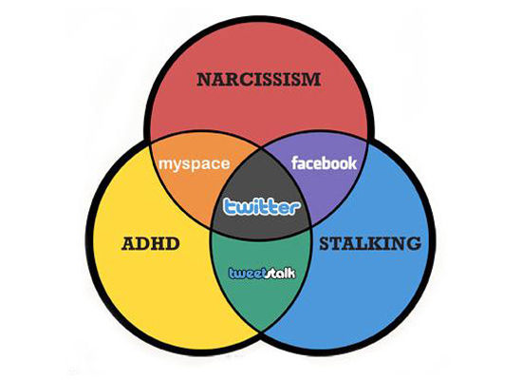
Outline
Set identities
Prove set equalities.

Slide 3
Set Identities
A
B
B
A
B
Compare with A-B = {x | x∈A ∧ x∉B}

Slide 4
Set Identities
A-B
Consider
This is De Morgan’s Law with X=A and Y=

Slide 5
Set Identities
Identity
Name
A∪∅ = A
Identity laws
A∩U = A
A∪U = U
Domination laws
A∩∅ = ∅
A∪A = A
Idempotent laws
A∩A = A
A
= A
Double Complement laws
4/12

Slide 6
Set Identities
Identity
Name
A∪B = B∪A
Commutative laws
A∩B = B∩A
A∪ (B∪C) = (A∪B) ∪C
Associative laws
A∩ (B∩C) = (A∩B) ∩C
A∩ (B∪C) = (A∩B) ∪ (A∩C)
Distributive laws
A∪ (B∩C) = (A∪B) ∩ (A∪C)
A∪B = A∩B
De Morgan’s laws
A∩B = A∪B

Slide 7
Set Identities
Identity
Name
A∪ (A ∩ B) = A
Absorption laws
A∩ (A ∪ B) = A
Alternate Representation for set difference
A-B = A∩B

Slide 8
Proving Set Equality
Recall. Two sets are equal if and only if they contain exactly the same elements, i.e., iff A⊆B and B⊆A
Three methods to prove set equality:
Show that each set is a subset of the other
Apply set identities theorems
Use membership table
7/12

Slide 9
Each Others’ Subset
Show that (B-A)∪ (C-A)=(B ∪ C)-A.
For any x ∈LHS, x ∈(B-A) or x ∈(C-A) [or both].
when
when
Therefore, LHS ⊆ RHS

Slide 10
Each Others’ Subset
Show that (B-A)∪ (C-A)=(B ∪ C)-A.
For any x ∈RHS, x ∈(B∪C) and x ∉A.
when x ∈B and x ∉A
when x ∈C and x ∉A,
Therefore, RHS ⊆ LHS
With LHS ⊆ RHS and RHS ⊆ LHS, we can conclude that LHS = RHS

Slide 11
Using Set Identities
Show that (A-B)-(B-C)=A-B.
(By alternate representation for set difference)
(By De Morgan’s laws)
(By Distributive laws)
(By Associative laws)
(By Idempotent laws)
(By Distributive laws)
(By Absorption laws)
(By the alternate representation for set difference)
10/12

Slide 12
Using Membership Tables
Similar to truth table (in propositional logic)
Columns for different set expressions
Rows for all combinations of memberships in constituent sets
“1” = membership , “0” =non-membership
Two sets are equal, iff they have identical columns
Prove that (A∪B)−B = A−B
∪
∪
−
−
A
B
A
B
(
A
B
)
−
B
A
−
B
0
0
0
0
0
0
1
1
0
0
1
0
1
1
1
1
1
1
0
0

Slide 13
Summary
Set identities
Prove set equalities
Each others’ subset
Set identities
Membership table

